Slide 1
Chiba Campaign Weekly Report 2018/11/13
Al Mashroor Fatmi

Slide 2
Site Name: Chiba University
Additional Site Information: $N 35°{37}^{′}{30}^{′′}, E 140°{06}^{′}14′′$
Elevation: 60m
Instrument: Skyradiometer
Period of Measurement: 1st Nov ~ 11th Nov, 2018

Slide 3
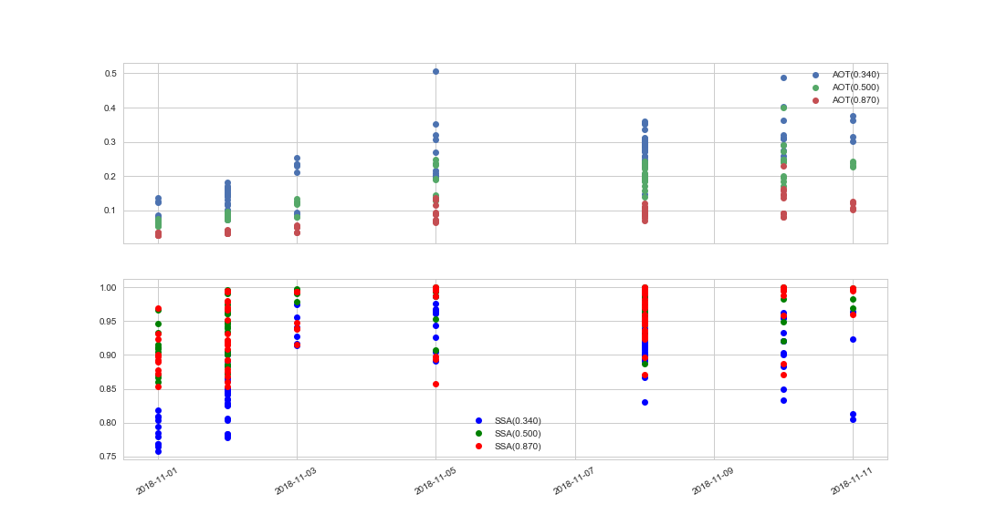
Possible AOT & SSA at 340, 500, 870 nm respectively

Slide 4
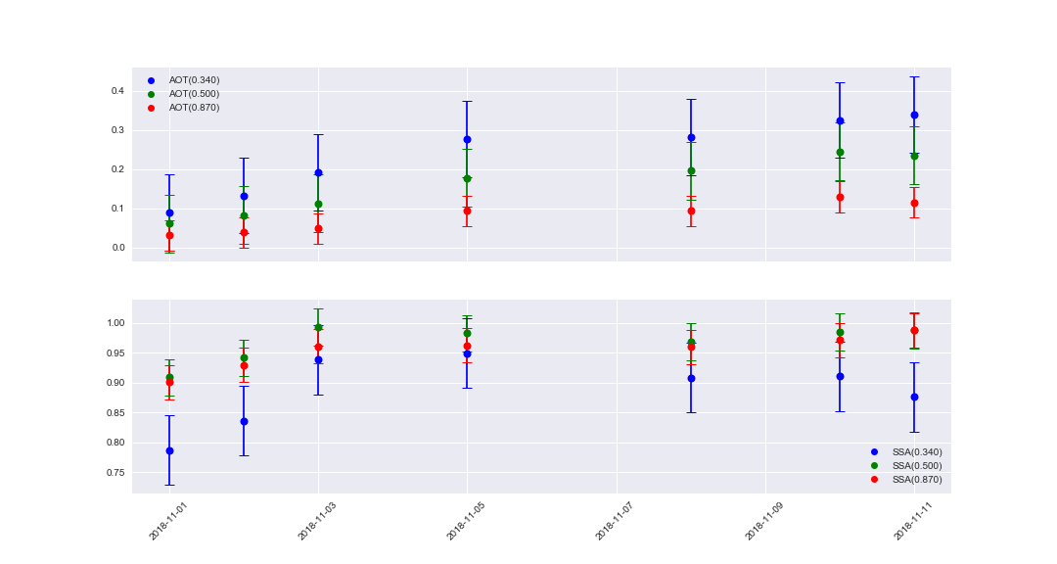
Daily mean of AOT & SSA at 340, 500, 870 nm respectively

Slide 5
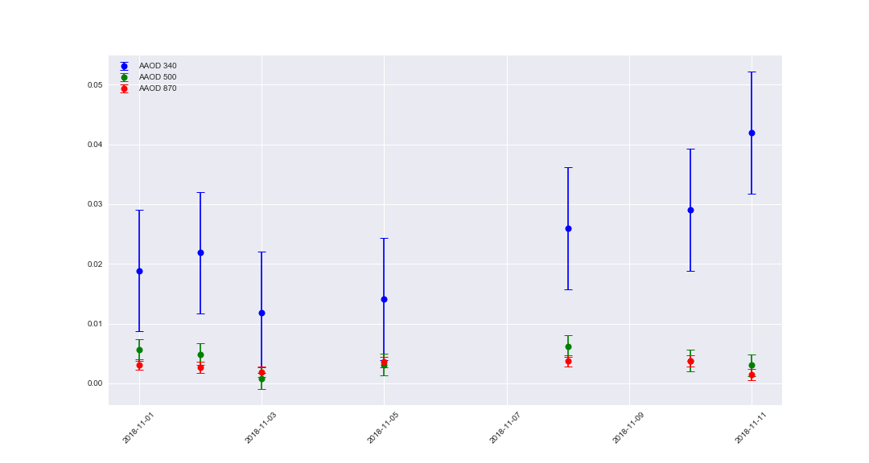
Daily mean of AAOD at 340, 500, 870 nm respectively

Slide 6
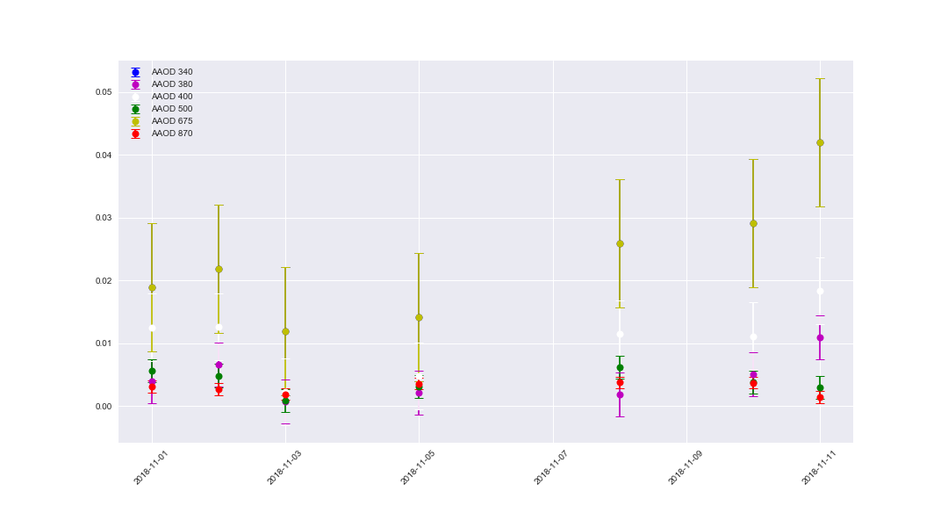
Daily mean of AAOD at all possible (340, 380, 400, 500, 675, 870 nm) respectively

Slide 7
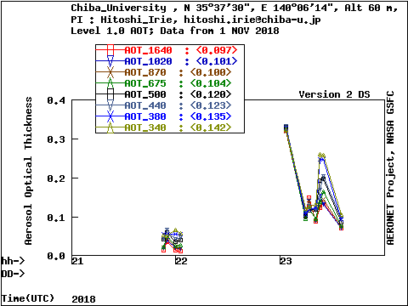
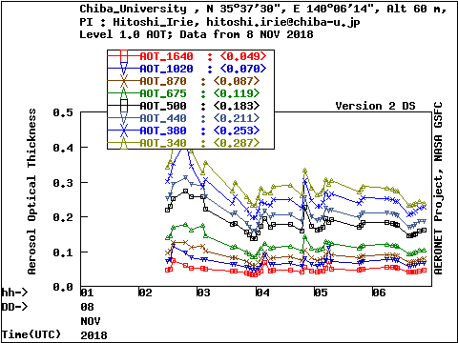
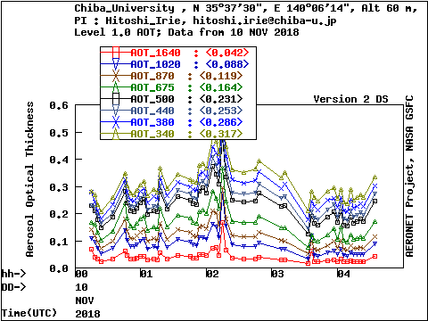
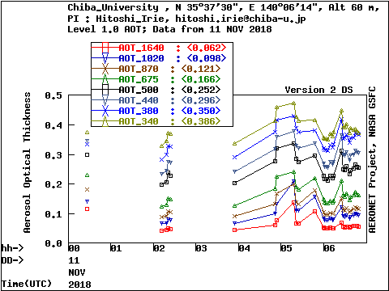
AOT observation by AERONET from 1st Nov to 11th Nov, 2018 respectively

Slide 8
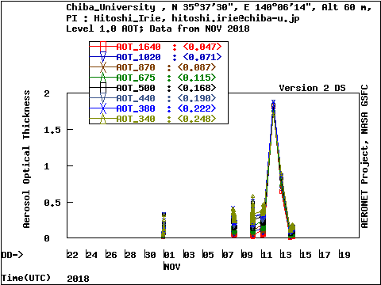
Overall AOT observation by AERONET from 1st Nov to 11th Nov, 2018

